Slide 1

SC1015 Mini Project:
Earthquake Prediction
C133 Team 4: Lee Min Han (U2222834A), Ravipudi Abhijeet Chowdary (U2220816C),
Leong Ling Min Fernando (U2220587L)

Slide 2


Table of Contents
Problem and Objective
Exploratory Dataset and Analysis
Methodologies
Insights and Conclusion

Slide 3

Practical Motivation
Real-life Problem
Predicting earthquake probability for a given coordinate can provide valuable information for disaster management and emergency response, and can ultimately help to save lives and reduce the impact of earthquakes on communities
Objective
Using an earthquake dataset, we will find out the probability of an earthquake happening given a pair of coordinates

Slide 4
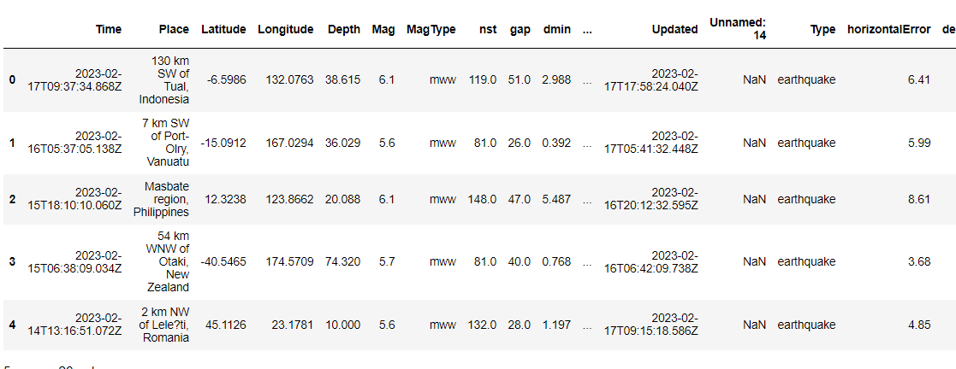
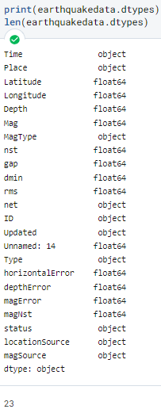
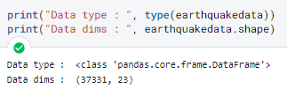

Data Preparation
Size of Dataset:
37331
Significant Earthquake Dataset 1900-2023
By Jahaidul Islam
https://www.kaggle.com/datasets/jahaidulislam/significant-earthquake-dataset-1900-2023

Slide 5
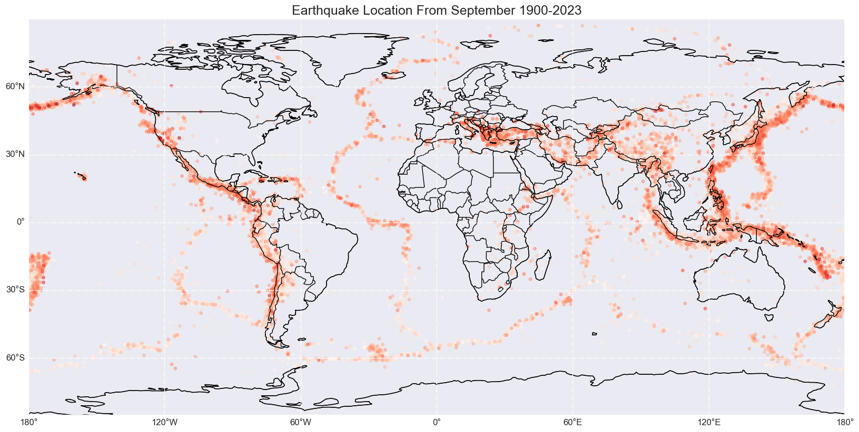
Data Preparation
Significant Earthquake Dataset 1900-2023
By Jahaidul Islam
https://www.kaggle.com/datasets/jahaidulislam/significant-earthquake-dataset-1900-2023

Slide 6
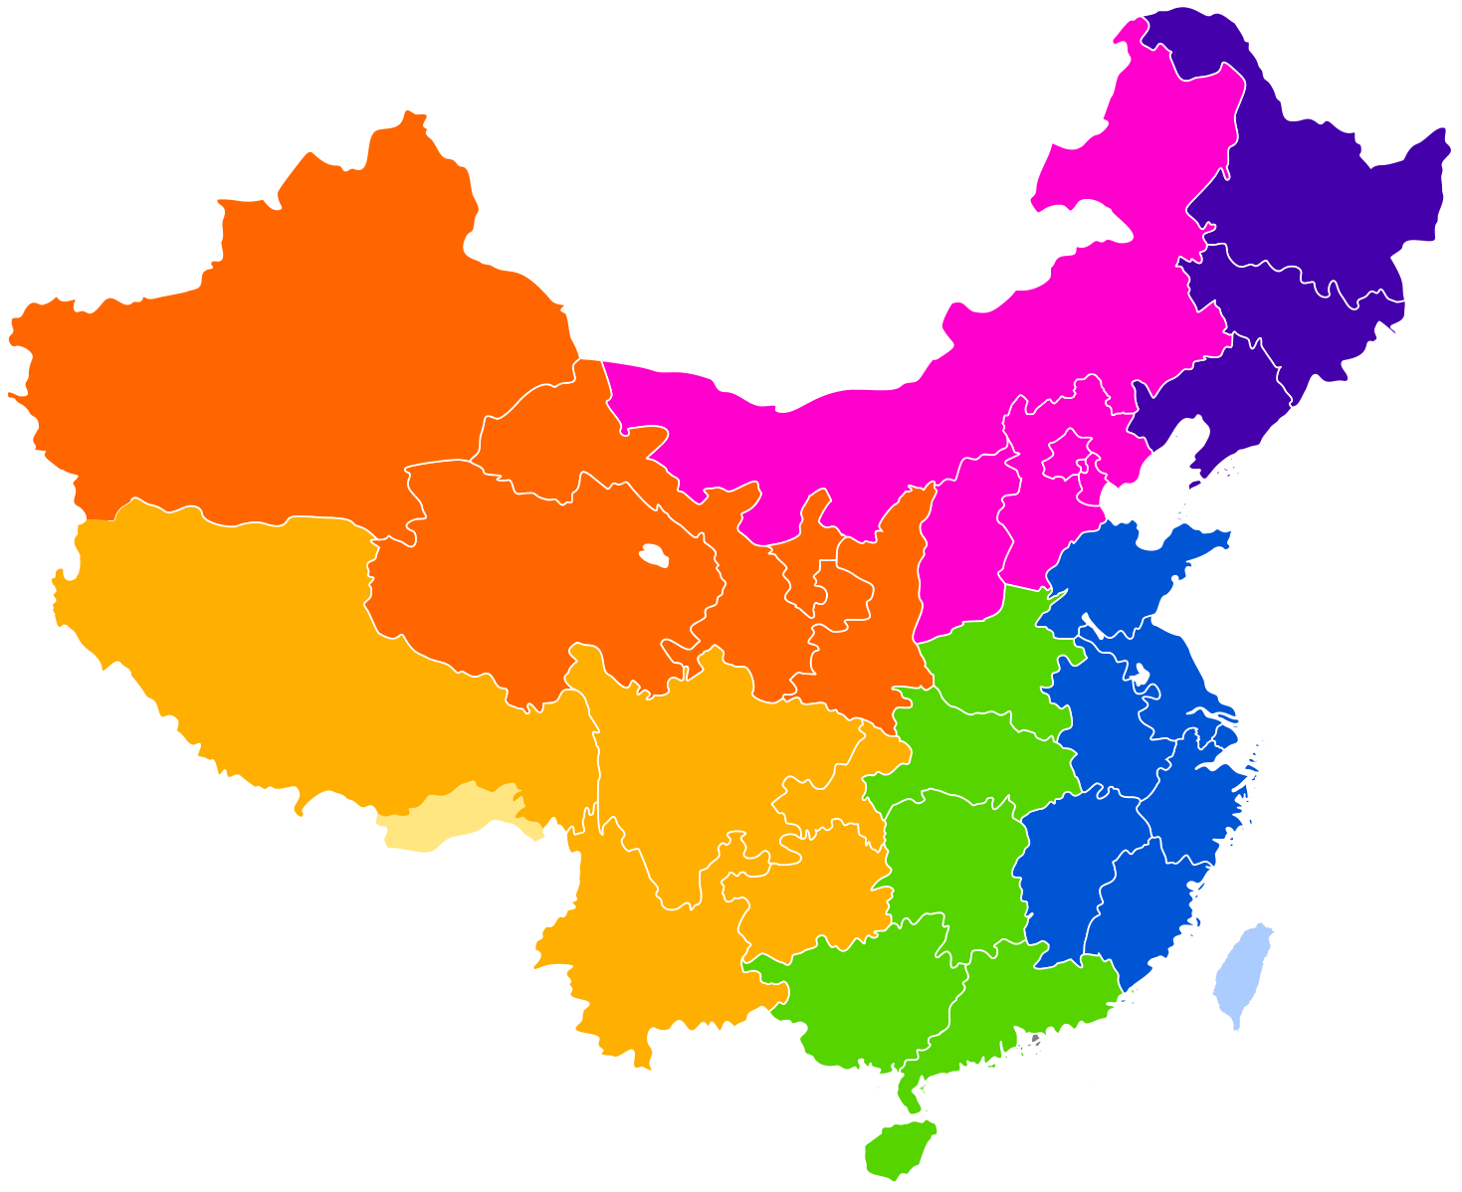
Problem Formulation
What is the probability of an earthquake occurring in a chosen location in China and its surroundings?
Notes:
The reason why we choose China is because we noticed during our data preparation that China has a large number of earthquakes that is spread with different densities through the region.

Slide 7

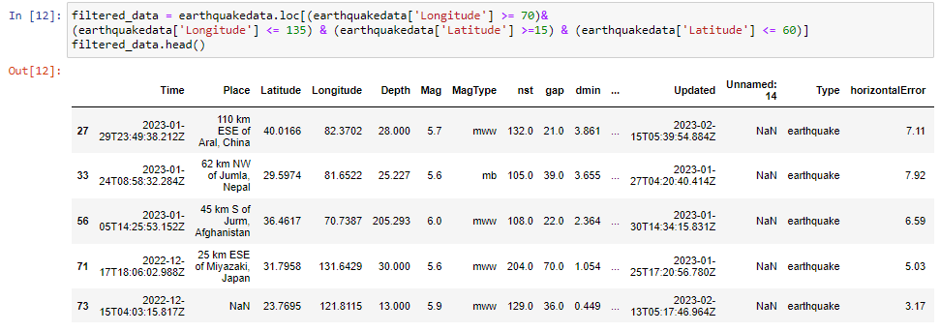
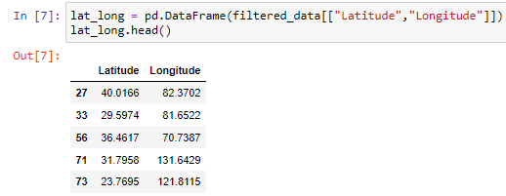
Exploratory Data Analysis
Filtered the data such that we only use data of earthquakes within and around China
Reason:
Limit our scope
Calculating probability would be more accurate in the clusters within a region
Filtered data within the China and surrounding region

Slide 8
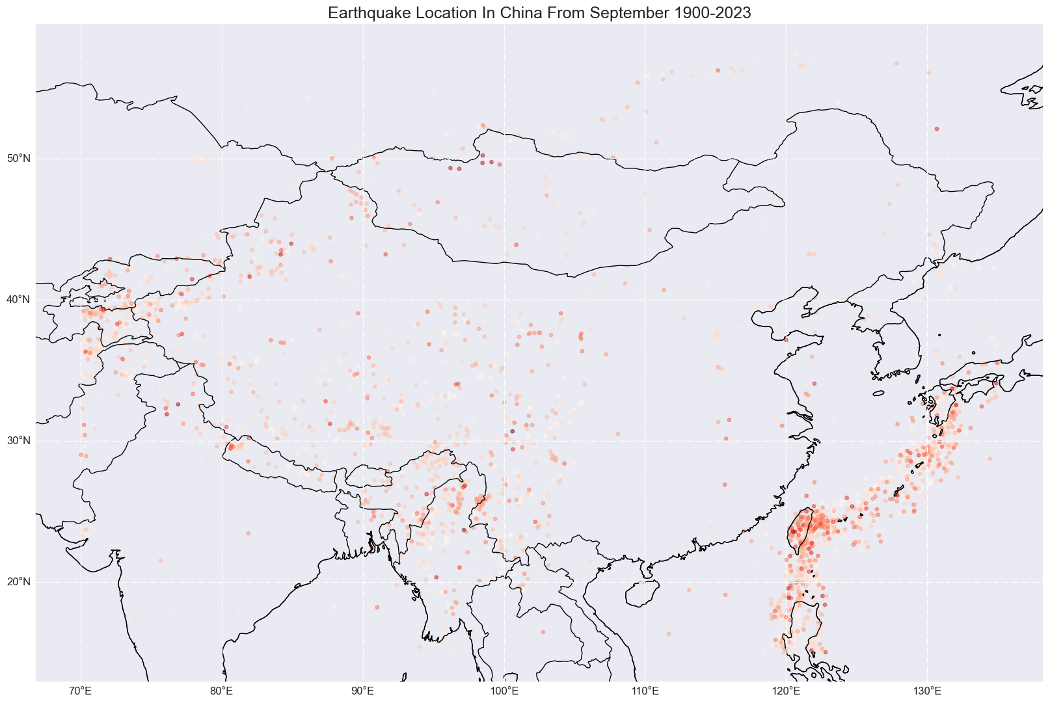
Data Visualisation
Notes:
We used cartopy

Slide 9
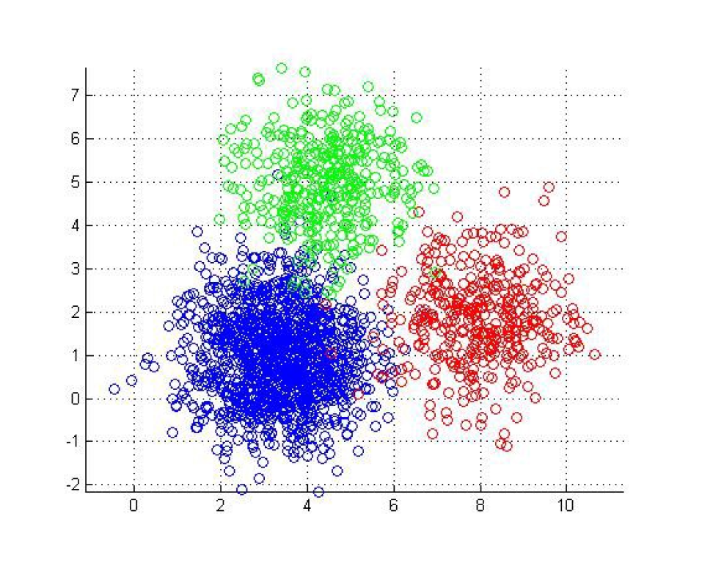
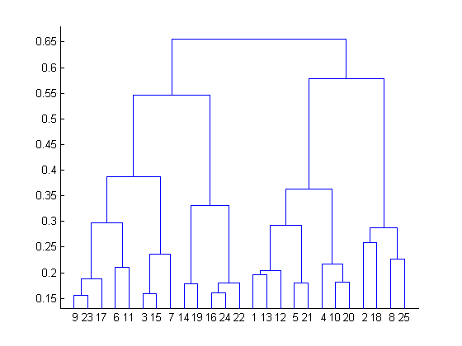
Methodology
Machine Learning Model
Clustering
K-means
Hierarchical
Notes:
We will be using Clustering to predict the probability of an earthquake as earthquakes normally occurs along fault lines and hence, we can group these points into different clusters to determine how far a chosen location is from these clusters and hence, calculate the probability of an earthquake happening at that point.
We will then be using 2 different clustering models, namely K-Means Clustering Model and Hierarchical Clustering Model, to compare which model would be the best at predicting the probability of an earthquake happening at that point

Slide 10
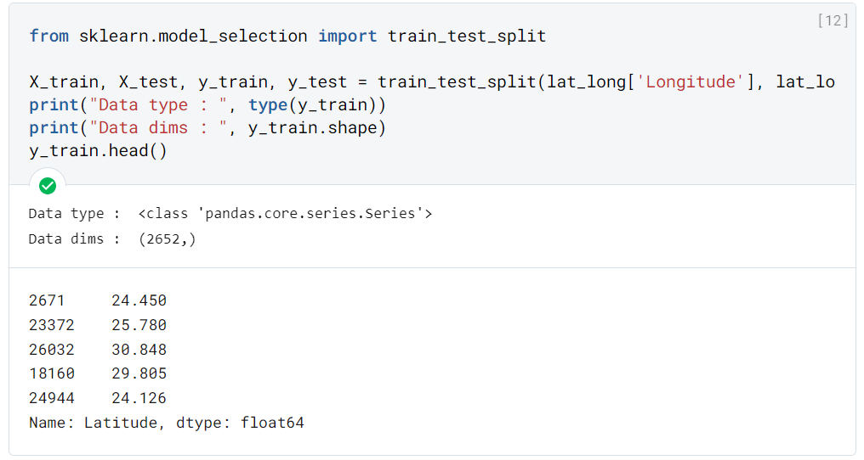
Methodology
Training the Model
Input: Earthquake Epicentre Coordinates
Output: Clusters of Earthquake Location
Split the data into train and test sets
Compare with existing data to determine effectiveness of model

Slide 11
Methodology
Hyperparameters of Model
Hyperparameters of K-Means Clustering Model: n_clusters and random_state
Hyperparameters for Hierarchical Clustering mode: n_clusters and linkage
Notes:
For the K-Means Clustering model, the hyperparameters used were n_clusters and random_state. This is because for K-Means model, we have to provide the algorithm with the number of clusters that we want, which we have done through iteration of the different number of clusters. In addition, we have to set random_state in order to generate the same clusters every single time because the clustering of the algorithm would change slightly every time we regenerate it.
As for Hierarchical Clustering model, the hyperparameters used were n_clusters and linkages. Similar to K-Means Clustering, we have to provide the algorithm with the number of clusters we want, which we have done through the iteration of different number of clusters as well. The linkage hyperparameter is used to determine the method of clustering, which will be shown in the Hierarchical Clustering section later on.

Slide 12
Methodology
Calculating the probability of an earthquake occurring at a location
We have opted for a heuristic approach to calculate the probability of an earthquake occurring at a location using the train set, with the probability given by the formula shown below:

Slide 13
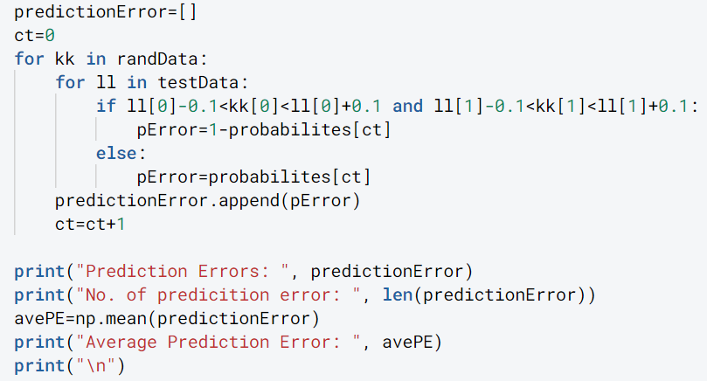
Methodology
Calculating the Prediction Error
Randomly generate 664 test points and their probabilities using the train set, and test it against whether an earthquake really occurred at the locations in the test set.
After generating the prediction errors for the 664 test points, we then calculate the average prediction error for the number of clusters for both models.
Notes:
As for Prediction error, we randomly generate 664 test points and their probabilities using the train set, and test it against whether an earthquake really occurred at the locations in the test set. The prediction error would be given by (1 - probability of earthquake occurring at the location using train set) if there was indeed an earthquake occurring at the location in the test set. If not, the prediction error would be the probability of earthquake occurring at the location using train set. After generating the prediction errors for the 664 test points, we then calculate the average prediction error for the number of clusters for both models.

Slide 14
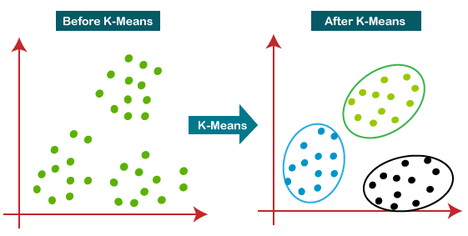
What is K-means Clustering?
Randomly selects K initial centroids
Each data point is then assigned to the cluster whose centroid is closest to it in terms of Euclidean distance.
Algorithm recalculates the centroids of each cluster as the mean of all the data points in that cluster
Notes:
The K-means algorithm starts by randomly selecting K initial centroids, which act as the centers of the clusters. Each data point is then assigned to the cluster whose centroid is closest to it in terms of Euclidean distance. Next, the algorithm recalculates the centroids of each cluster as the mean of all the data points in that cluster. This process is repeated iteratively until the centroids no longer move significantly, or a maximum number of iterations is reached.

Slide 15
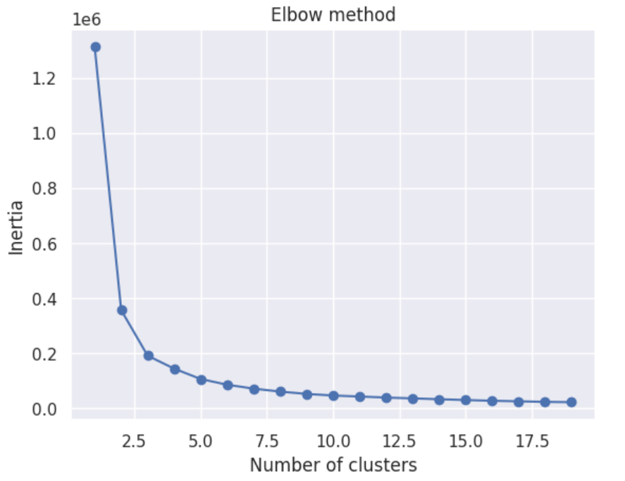
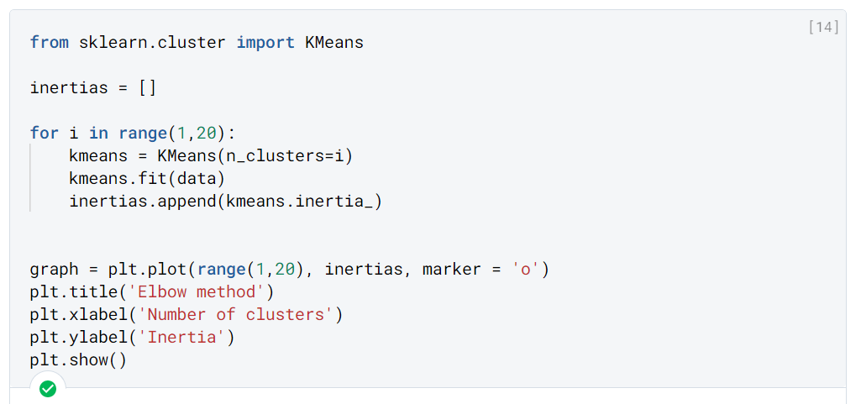
K-Means Clustering
Decided to use 3 clusters as a middle point as it is the point where the curve starts to flatten, just like an elbow
Chose to do a range from 1 to 5 clusters to see which is the best cluster.
Notes:
Using the elbow method as a reference to determine the number of clusters, we decided to use 3 clusters as a middle point as it is the point where the curve starts to flatten, just like an elbow, and as such, we have chose to do a range from 1 to 5 clusters to see which is the best cluster.

Slide 16
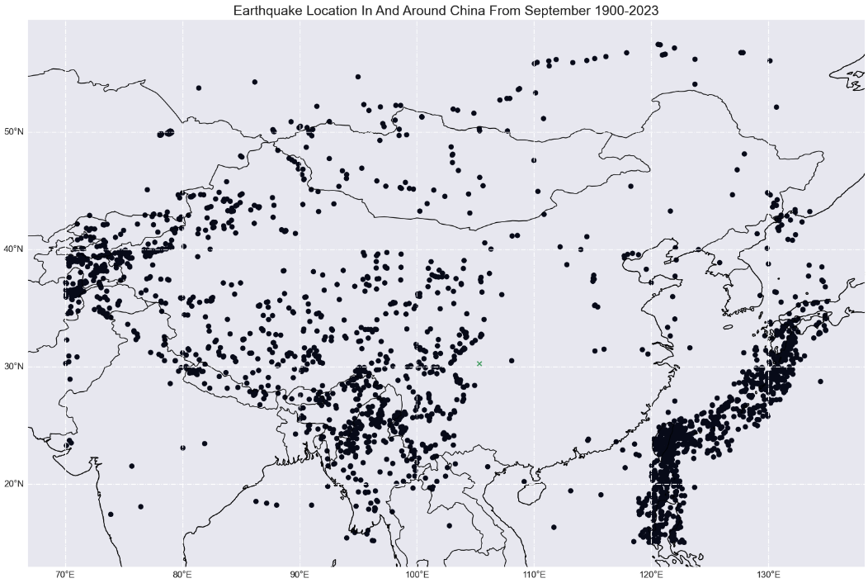
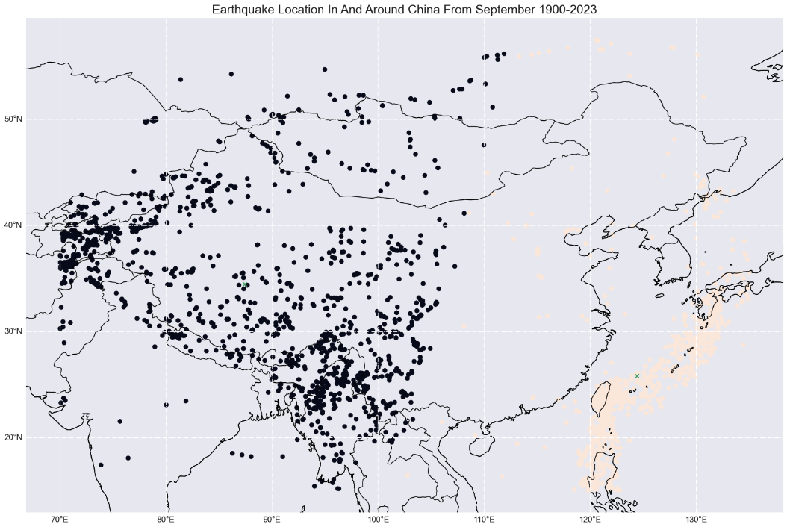
K-Means Clustering
Coordinates of random point generated: (107.1412, 34.3)
1 Cluster:
Coordinates of centroid of nearest cluster: (105.3037, 30.2905)
Probability of earthquake happening at test point: 0.8784305950343161
Average Prediction Error: 0.39514568899934893
2 Clusters:
Coordinates of centroid of nearest cluster: (124.4156, 25.8194)
Probability of earthquake happening at test point: 0.1935104099435161
Average Prediction Error: 0.28601936619348195

Slide 17
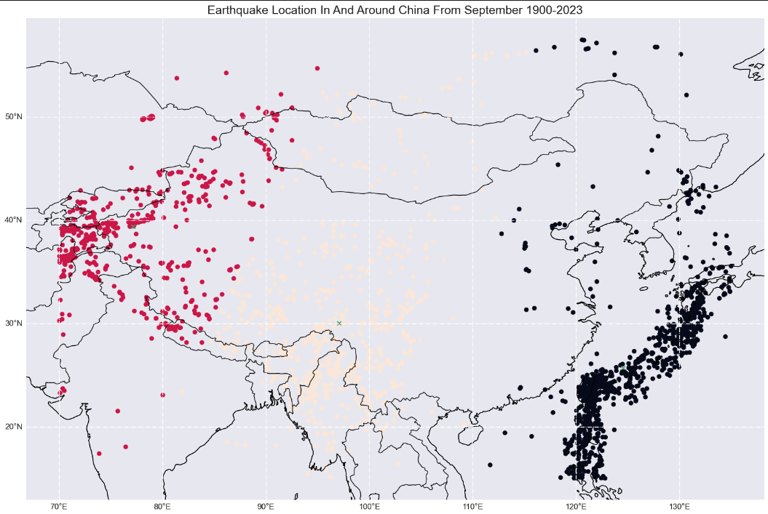
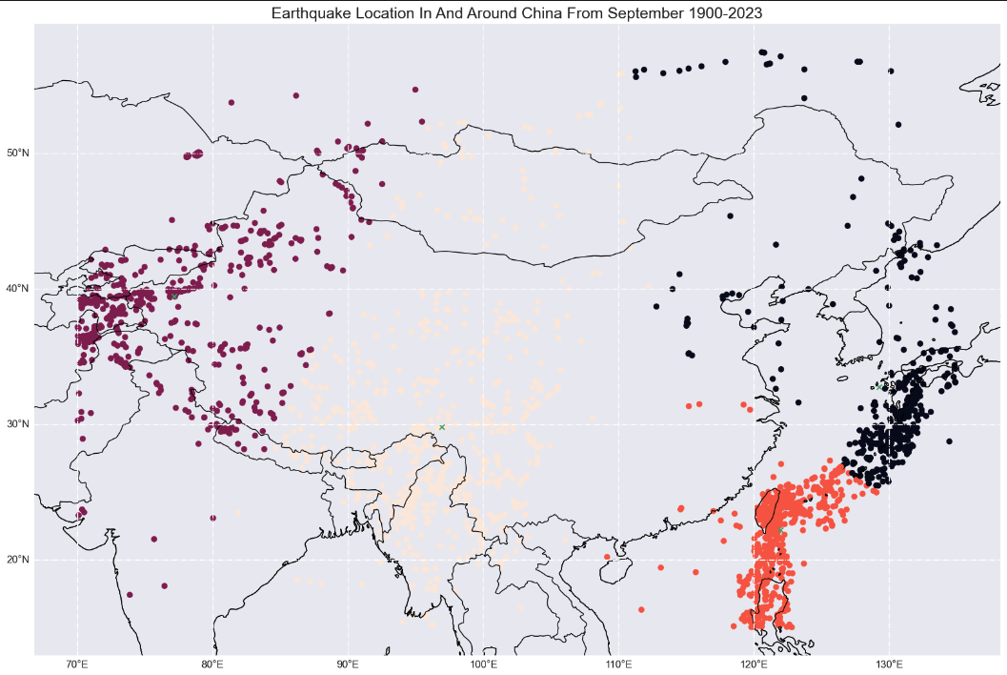
K-Means Clustering
Coordinates of random point generated: (107.1412, 34.3)
3 Clusters:
Coordinates of centroid of nearest cluster: (97.0897, 30.0555)
Probability of earthquake happening at test point: 0.17969852330722139
Average Prediction Error: 0.16831421111751016
4 Clusters:
Coordinates of centroid of nearest cluster: (96.9292, 29.8278)
Probability of earthquake happening at test point: 0.1675810932404978
Average Prediction Error: 0.16996636257275577

Slide 18
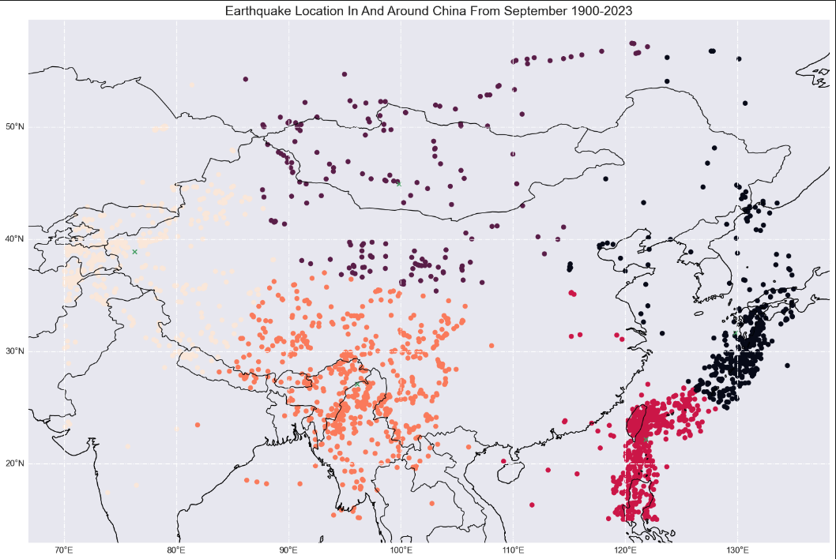
K-Means Clustering
Coordinates of random point generated: (107.1412, 34.3)
5 Clusters:
Coordinates of centroid of nearest cluster: (99.8480, 44.9339)
Probability of earthquake happening at test point: 0.033443168368501155
Average Prediction Error: 0.048489603837849025
Best number of clusters for K-Means Model is 5, as it has the lowest average prediction error of about 0.05
Notes:
As we can see, the best hyperparameter configuration of n_clusters for K-Means Clustering model is 5 as it has the lowest prediction error, which indicates that having 5 clusters to predict the probability of an earthquake is the best.

Slide 19
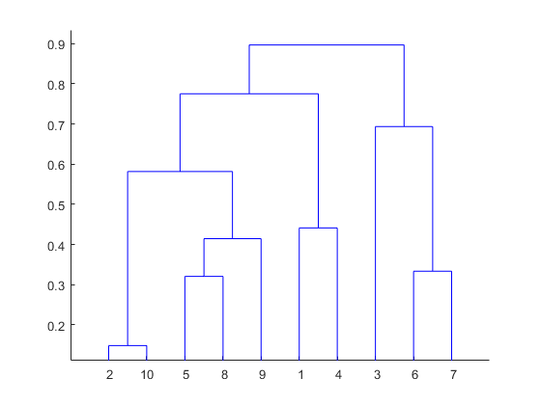
What is Hierarchical Clustering?
Treats each data point as a separate cluster and computing the pairwise distances between all the clusters
Two closest clusters merged to form a new cluster, and the process is repeated until all data points belong to a single cluster
Notes:
Moving on to Hierarchical Clustering, the hierarchical clustering algorithm starts by treating each data point as a separate cluster and computing the pairwise distances between all the clusters. The two closest clusters are then merged to form a new cluster, and the process is repeated until all data points belong to a single cluster. There are two main types of hierarchical clustering algorithms but today we will be focusing on Agglomerative clustering. The result of hierarchical clustering is a dendrogram, which is a tree-like structure that shows the hierarchical relationship between the clusters.

Slide 20
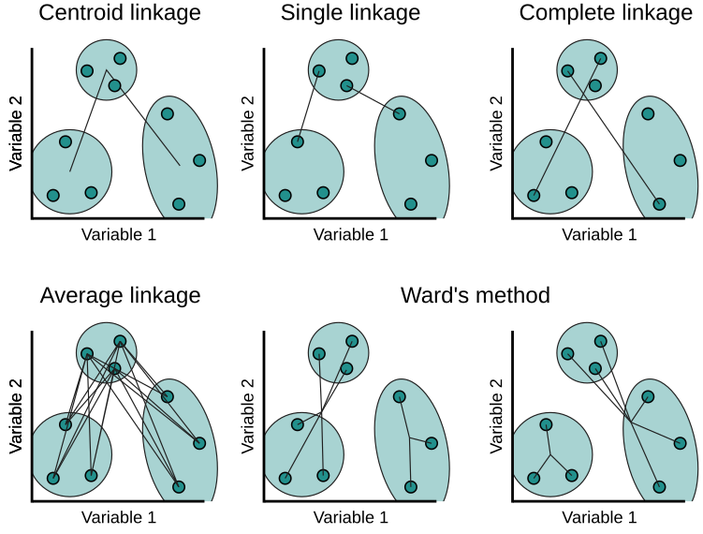
Different types of Linkages for Hierarchical Clustering
Measures the distance between two clusters as the minimum distance between any two points in the two clusters
Measures the distance between two clusters as the average distance between all pairs of points in the two clusters
Measures the distance between two clusters as the maximum distance between any two points in the two clusters
Seeks to minimize the variance of the distances (sum of squared distances) between the clusters being merged at each step
Notes:
As stated earlier, one of the hyperparameters for Hierarchical Clustering is linkages. The type of linkage determines how the clusters are formed. There are 4 types of linkages, namely single, average, complete, and ward.
Single linkage measures the distance between two clusters as the minimum distance between any two points in the two clusters.
Average linkage measures the distance between two clusters as the average distance between all pairs of points in the two clusters.
Complete linkage measures the distance between two clusters as the maximum distance between any two points in the two clusters.
Ward linkage seeks to minimize the variance of the distances between the clusters being merged at each step. In other words, it aims to merge clusters in a way that minimizes the increase in the sum of squared distances from each point to its cluster centroid.

Slide 21
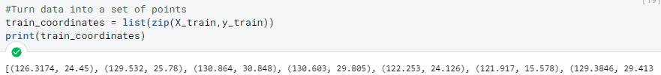
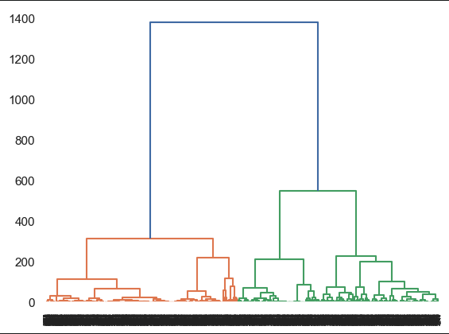
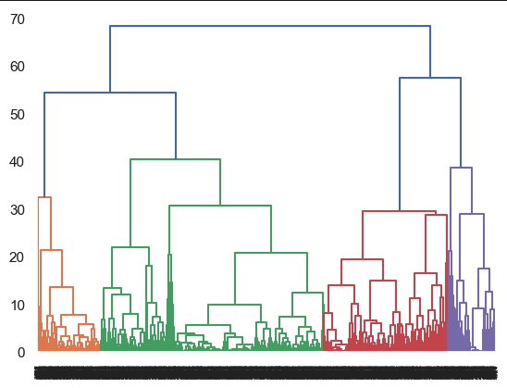
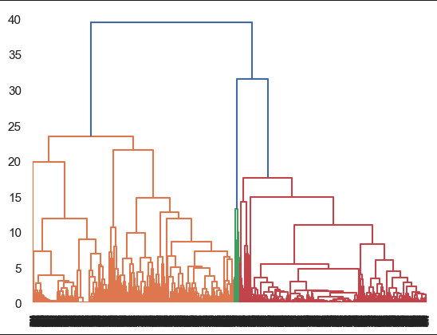
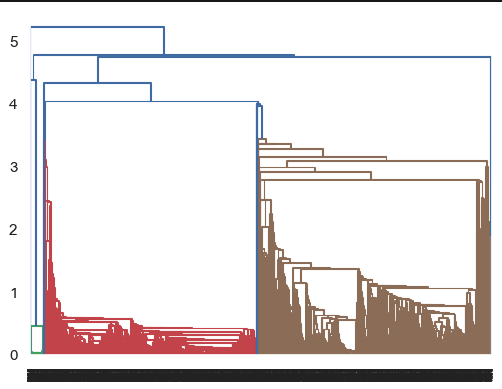
Hierarchical Clustering
Ward
Complete
Average
Single
Notes:
To find the the optimal number of clusters, we locate the highest vertical distance of the dendrogram, which is 2 for ward and single or 3 for average and complete. Therefore, we will use 2 as a reference starting point to find out the probability till clusters of 5 for each linkage method later on.

Slide 22
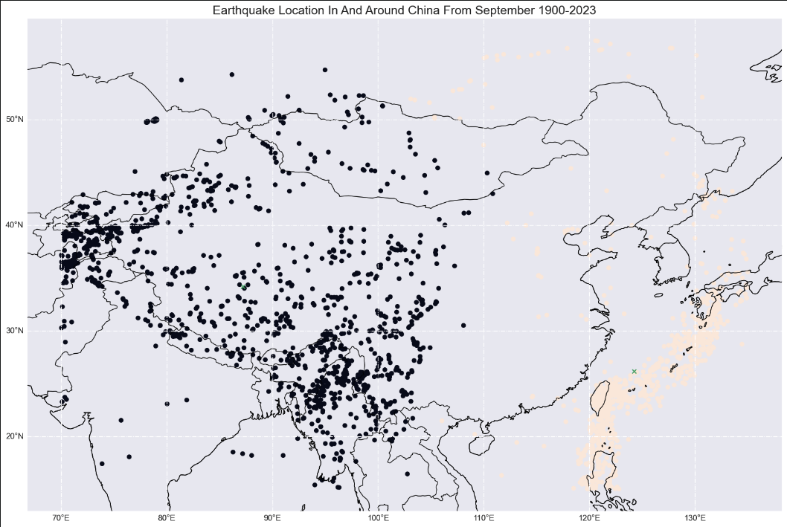
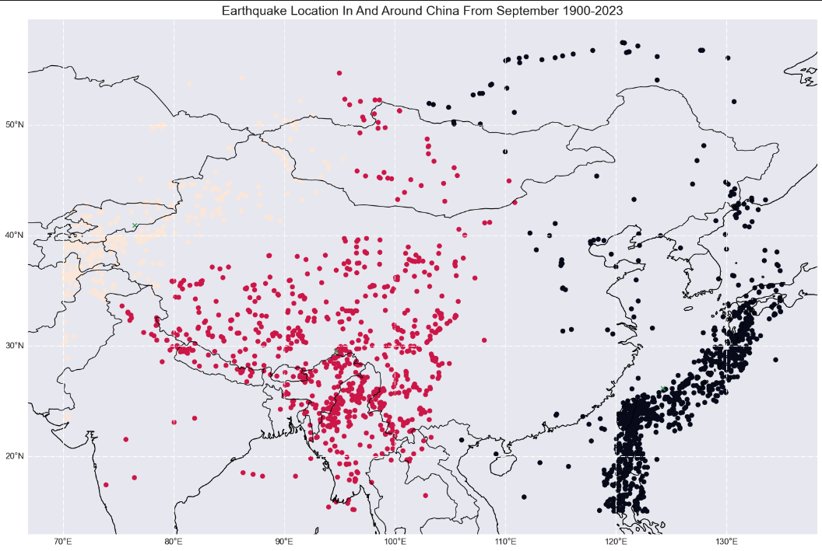
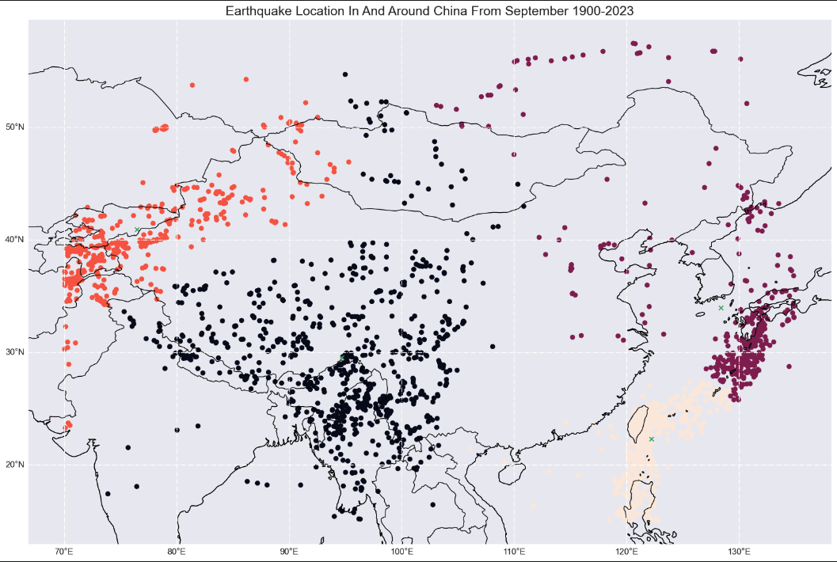
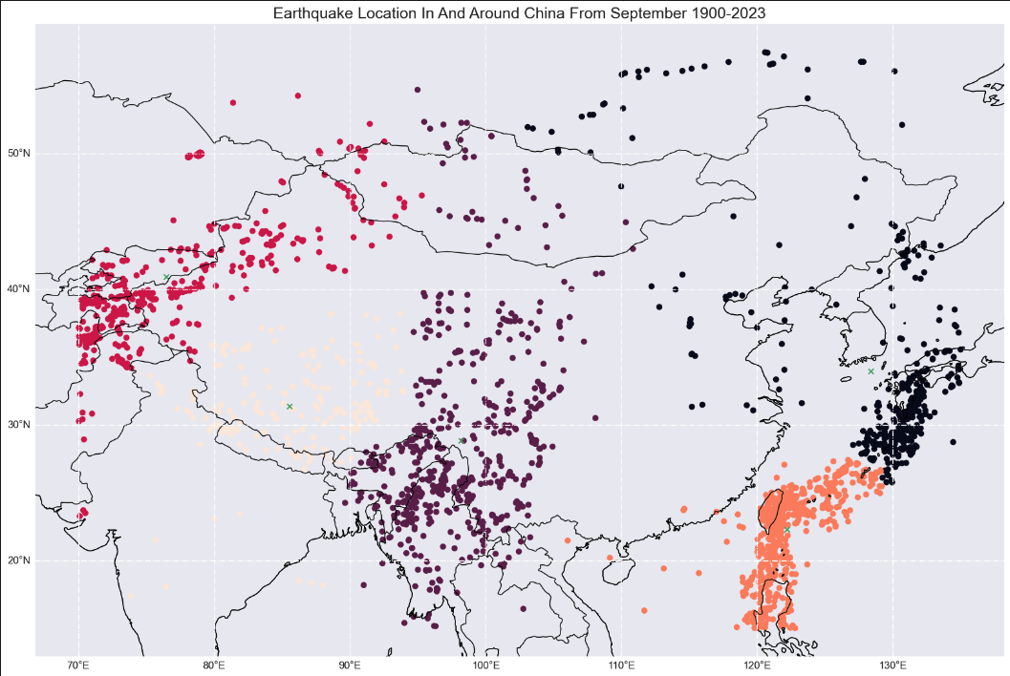
Hierarchical Clustering for Ward Linkage
For 2 Clusters, Average Prediction Error:
0.10381625223630506
For 3 Clusters, Average Prediction Error:
0.12989858382483366
For 4 Clusters, Average Prediction Error:
0.13919564927019612
For 5 Clusters, Average Prediction Error:
0.14743415364194556
Notes:
To determine the prediction error using the Hierarchical Clustering Model, we did the same thing as what we did for K-Means, using 664 random datasets to test the probability of earthquake happening using the train set against the test set, and then calculate the average prediction error for the different number of clusters and linkages.
For Ward Linkage, we can see that the average prediction error is the lowest for 2 clusters and highest for 5 clusters.

Slide 23
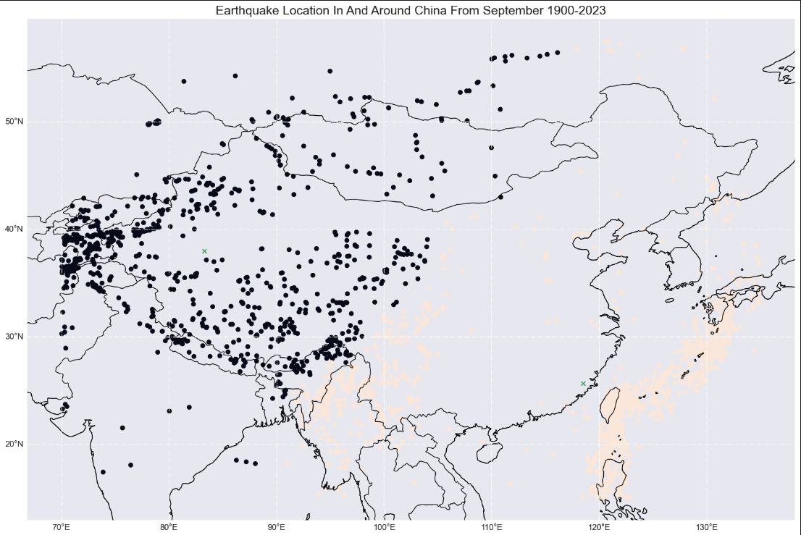
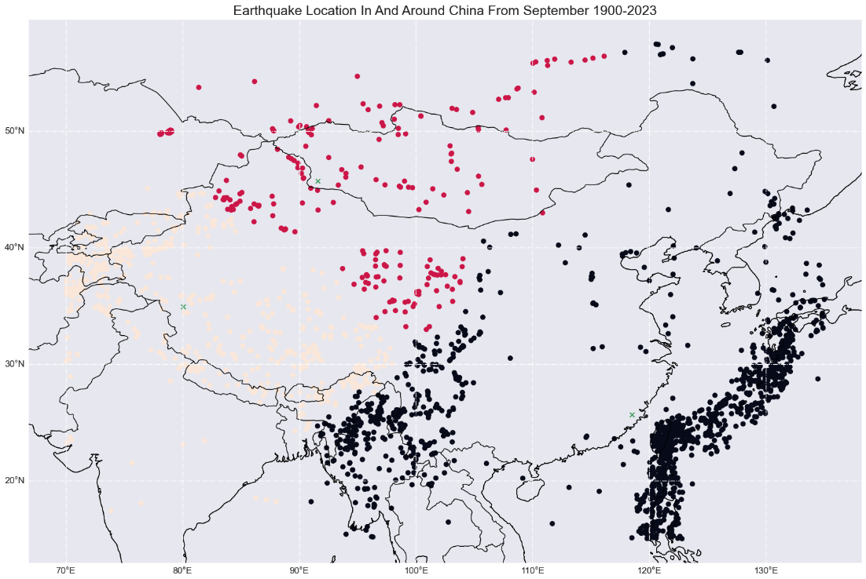
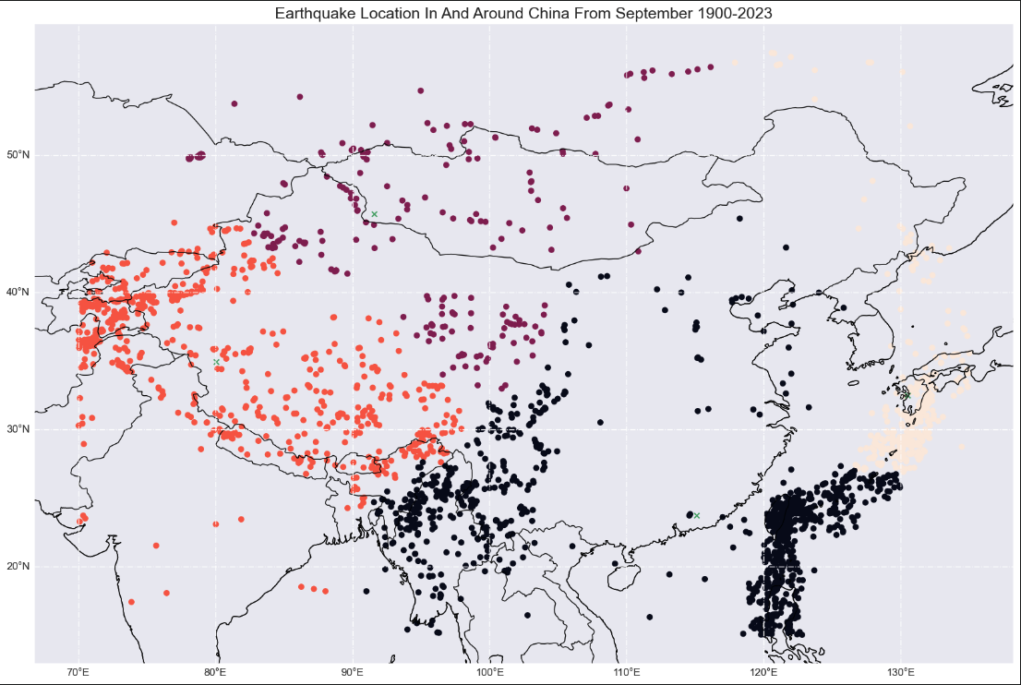
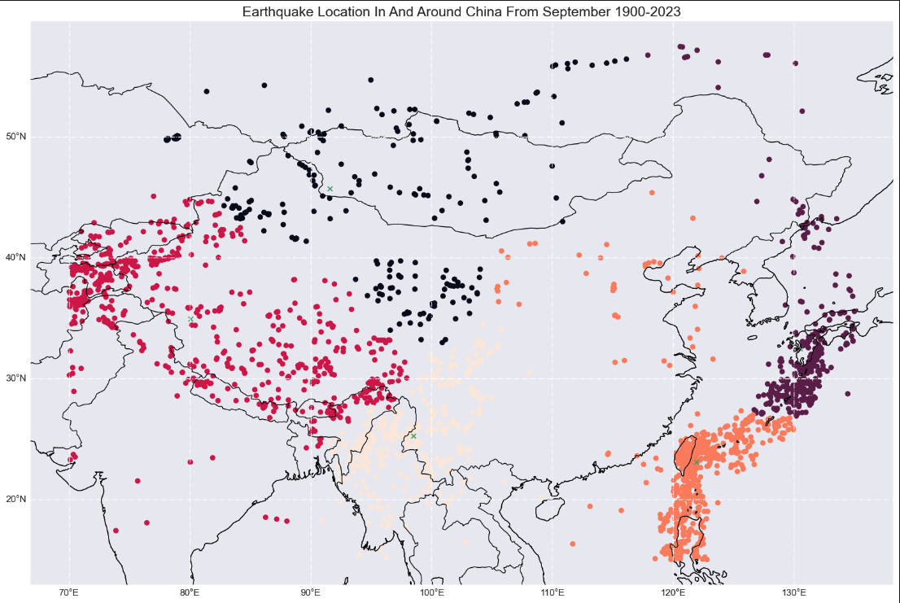
Hierarchical Clustering for Complete Linkage
For 2 Clusters, Average Prediction Error:
0.10844071311172294
For 3 Clusters, Average Prediction Error:
0.13292070173197237
For 4 Clusters, Average Prediction Error:
0.1473682841086295
For 5 Clusters, Average Prediction Error:
0.15361032219322912
Notes:
For Complete Linkage, the average prediction error is also the lowest for 2 clusters and highest for 5 clusters.

Slide 24
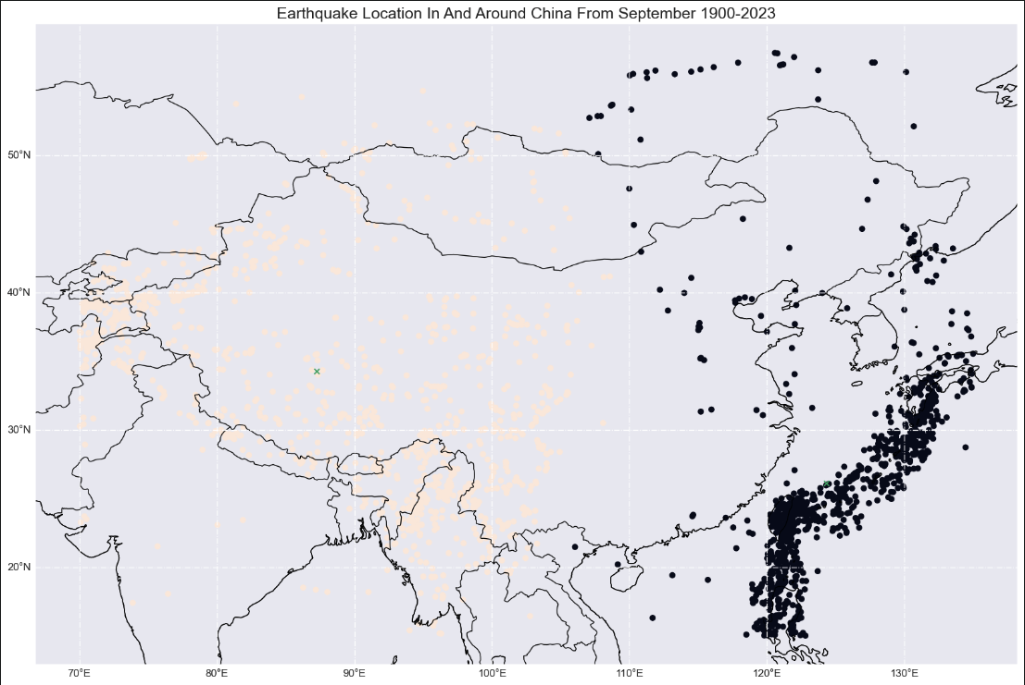
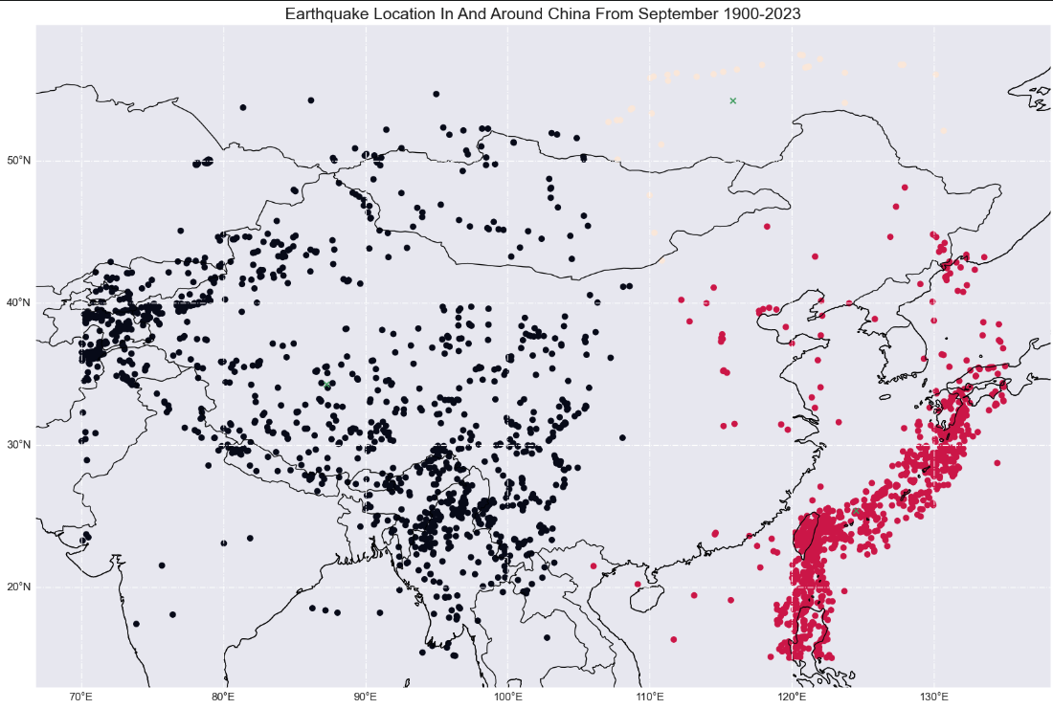
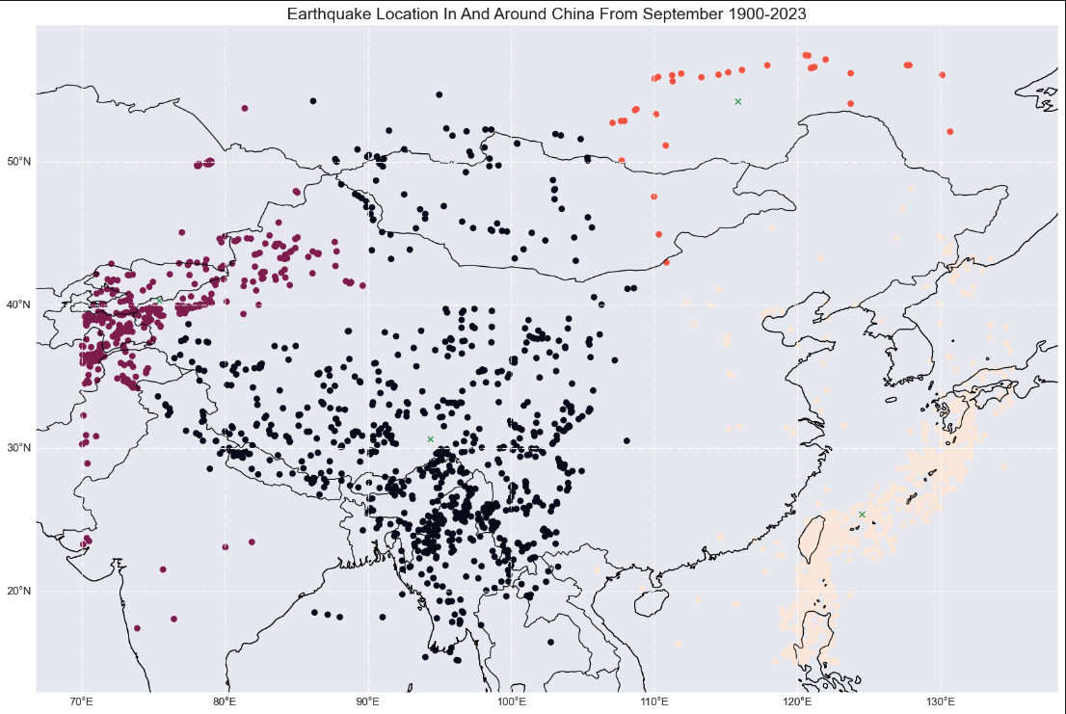
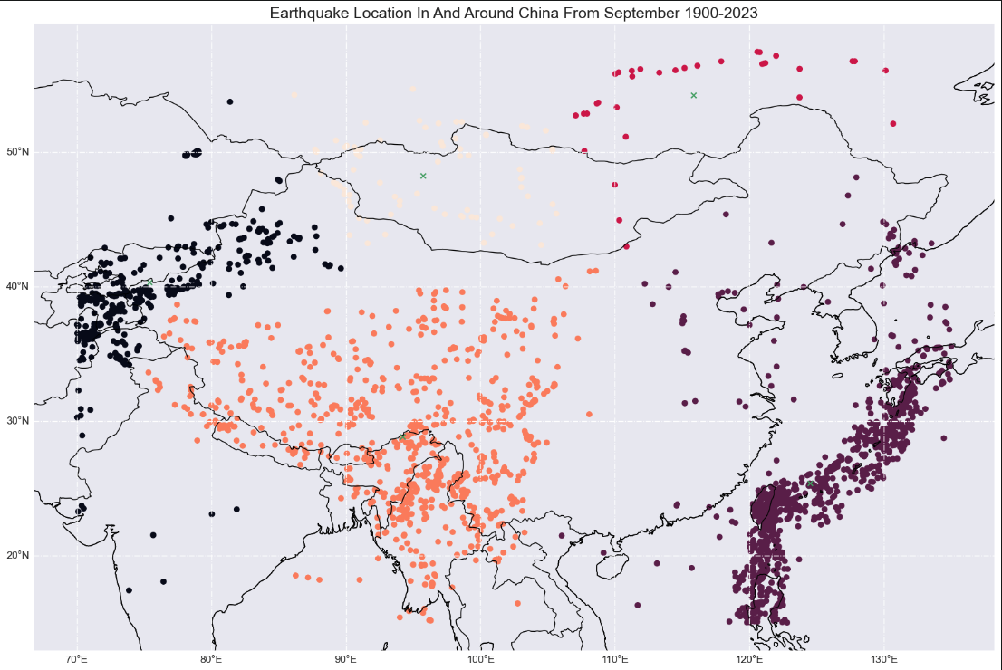
Hierarchical Clustering for Average Linkage
For 2 Clusters, Average Prediction Error:
0.1025509948732408
For 3 Clusters, Average Prediction Error:
0.12695915738110702
For 4 Clusters, Average Prediction Error:
0.1514782489245413
For 5 Clusters, Average Prediction Error:
0.16589577946489853
Notes:
Similarly, the average prediction error is the lowest for 2 clusters and highest for 5 clusters for Average Linkage,

Slide 25
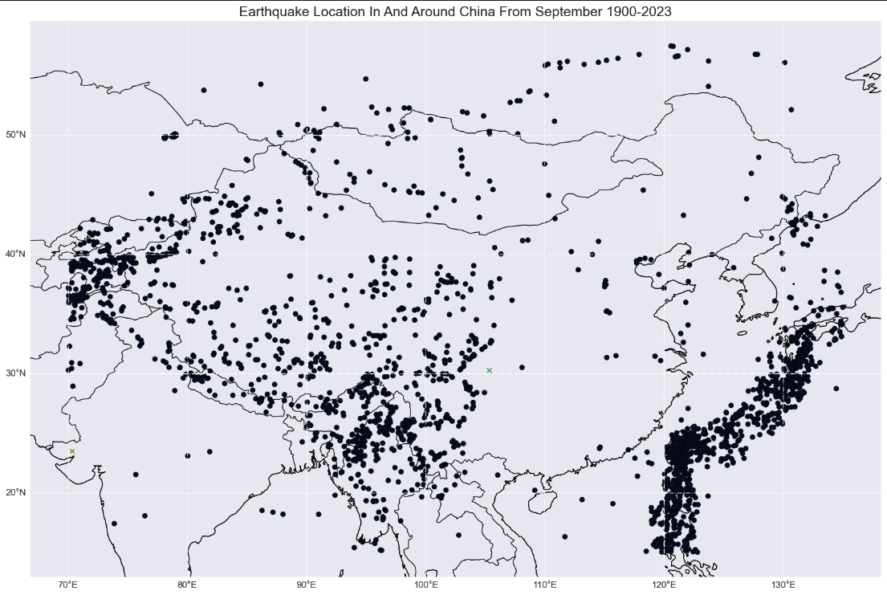
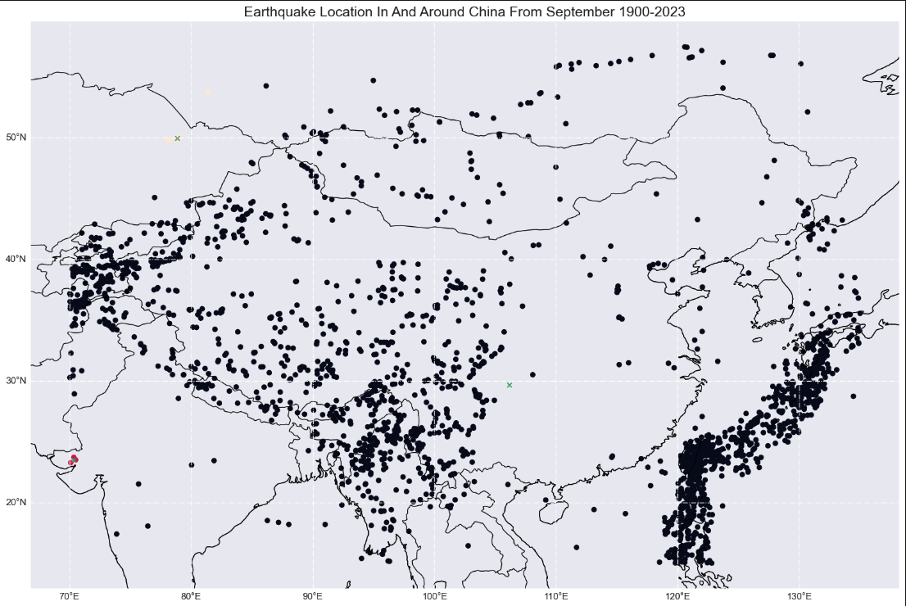
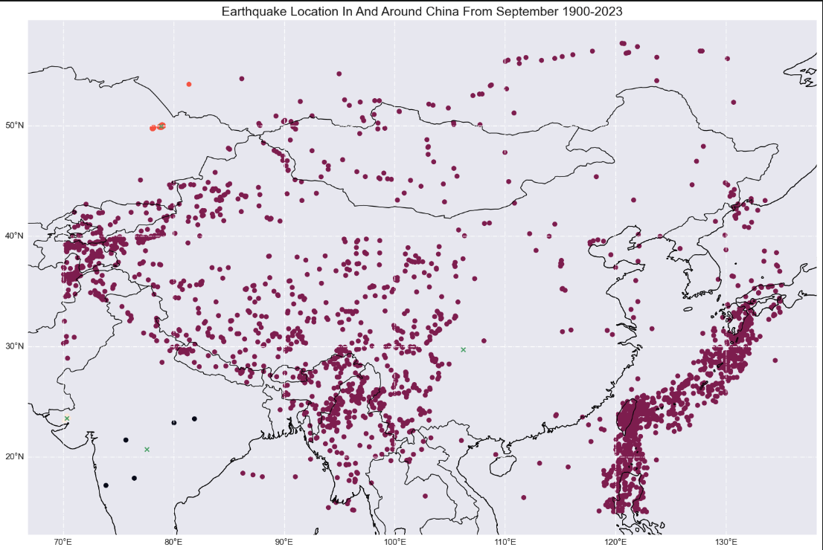
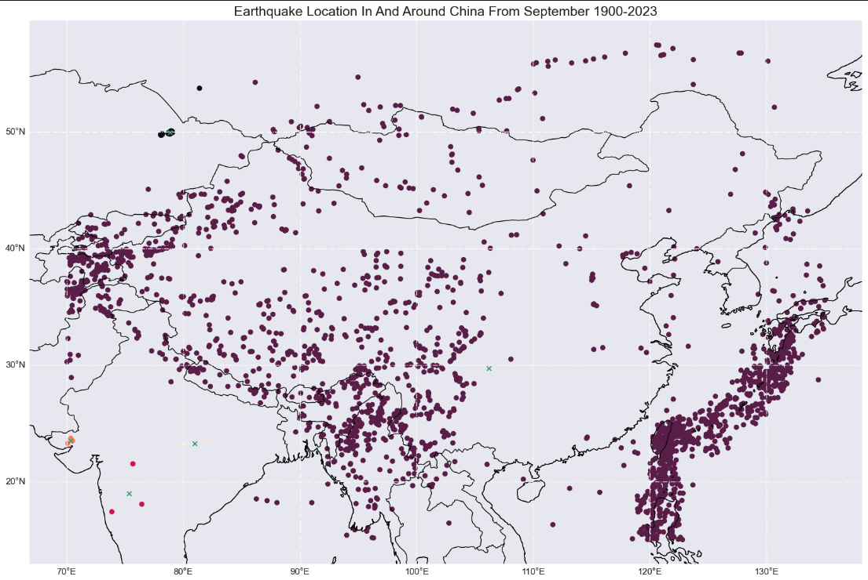
Hierarchical Clustering for Single Linkage
For 2 Clusters, Average Prediction Error:
0.103612103856738
For 3 Clusters, Average Prediction Error:
0.1277263044824807
For 4 Clusters, Average Prediction Error:
0.13030150693914183
For 5 Clusters, Average Prediction Error:
0.1351287892706932
Notes:
Lastly, for single linkage, the average prediction error is also the lowest for 2 clusters and highest for 5 clusters.

Slide 26
Hierarchical Clustering
Coordinates of random point generated: (132.1422, 57.6522)
Linkage: Average
2 Clusters:
Coordinates of centroid of nearest cluster:
(124.2961, 26.1098)
Probability of earthquake happening at test point:
0.007206933494481052
Average Prediction Error:
0.1025509948732408
Hyperparameter of linkage: “average” and n_clusters: 2 is the best
Notes:
By analysing every iteration of the number of cluster and linkage used in the model, we can see that the lowest average prediction error occurs when the hyperparameters of linkage and number of clusters are "average" and 2 respectively.Therefore, using 2 clusters together with the “average” linkage, is the best for hierarchical clustering.

Slide 27
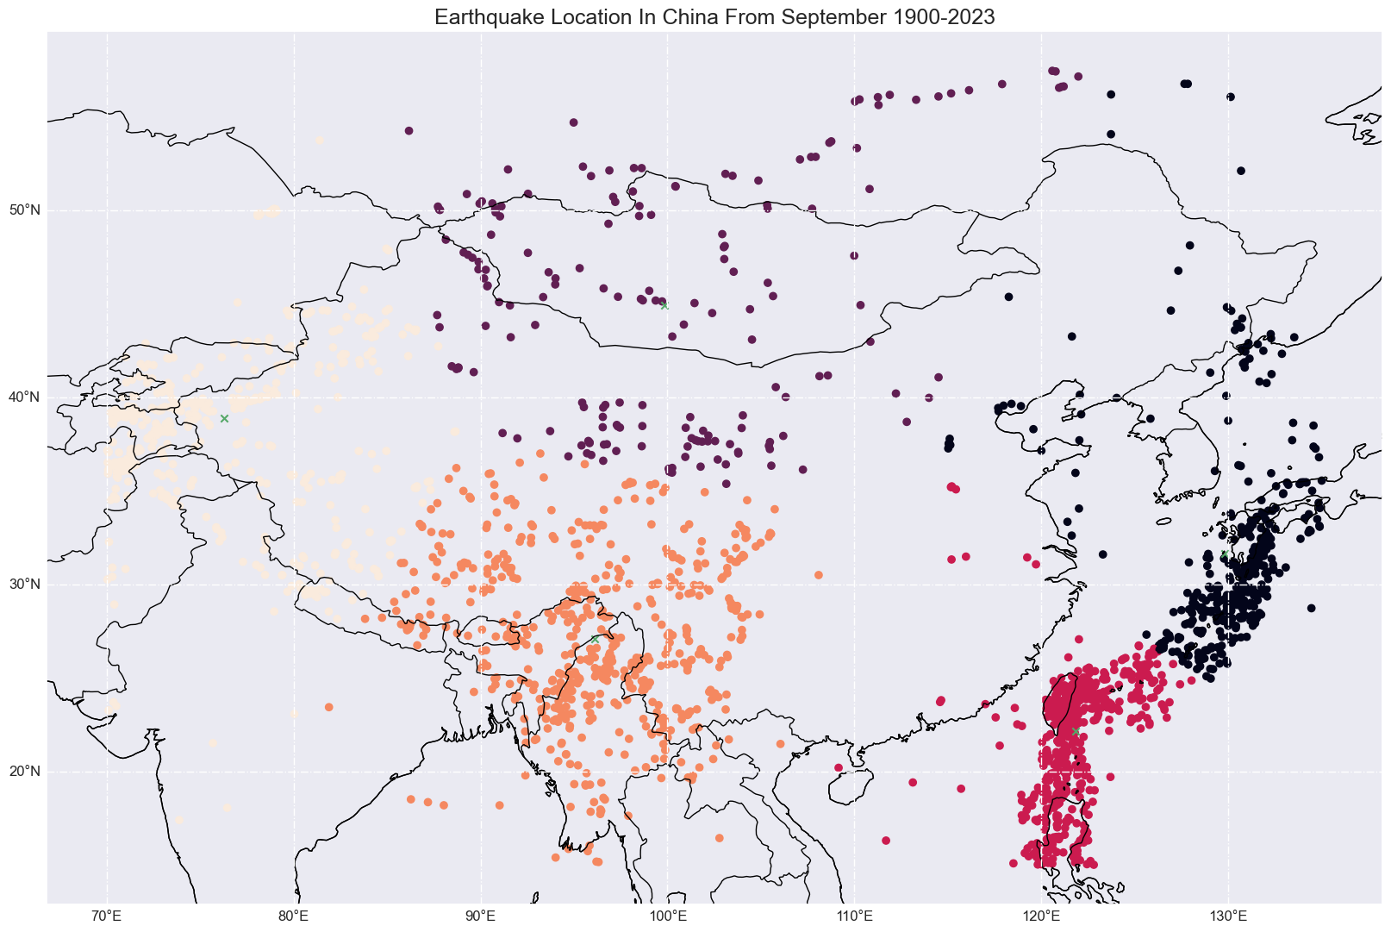
Choosing the best model to predict probability of earthquake at a location
Hierarchical Clustering Model with linkage hyperparameter: “average” (2 Clusters)
K-Means Clustering Model (5 Clusters)
Average Prediction Error: 0.048489603837849025
Average Prediction Error:
0.1025509948732408
Comparing the average prediction error of both models, we then conclude that the K-Means clustering model with 5 clusters would be the best at predicting probability of an earthquake at a location
Notes:
Now, when comparing the the average prediction error between K-Means Clustering and Hierarchical Clustering, we found out that the K-Means Clustering with 5 clusters is a better model in predicting the probability of an earthquake happening at a location, as compared to the Hierarchical Clustering with 2 clusters when linkage is "average", as the average prediction error for K-Means Clustering with 5 clusters is about 0.05, which is lower than the Hierarchical Clustering with 2 clusters when linkage is "average", with an average prediction error of about 0.10.

Slide 28
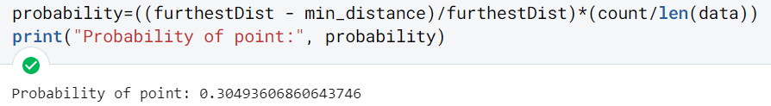
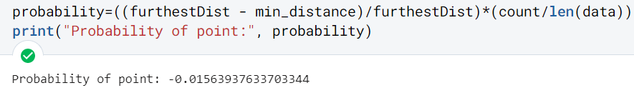
Conclusion
Using the K-Means model with 5 clusters, we calculate the probability of an earthquake at 2 extreme locations: 1) near the centroid of a cluster
2) location that is very far away from the centroid of the nearest cluster
Near the centroid of a cluster Coordinates: (122,22)
Limitations of model:
As seen from the bottom diagram, if we choose a coordinate that is on or further than the furthest point from the cluster, the probability of an earthquake happening will be 0 or negative respectively
Location very far from centroid of nearest cluster Coordinates: (69,17)
Notes:
Having decided that the K-Means model with 5 clusters would be the best to predict the probability of an earthquake at any location, we then used the model to test the probability of an earthquake at 2 extreme locations, one near the centroid of a cluster and one that is very far from the centroid of the nearest cluster, so that we can test the limits of our model.
We can see that the probability of earthquake happening at the first location is about 0.30, which is almost the same as the probability of an earthquake occurring at the centroid of that cluster. However, the probability of the earthquake happening at the second location is negative. As such, when analysing the K-Means Clustering Model used to calculate the probability of the earthquake, we realised that the heuristic approach has its limitations. For example, if the location is exactly the same or further than the furthest point from the cluster, the probability of an earthquake happening will be 0 or negative respectively.

Slide 29
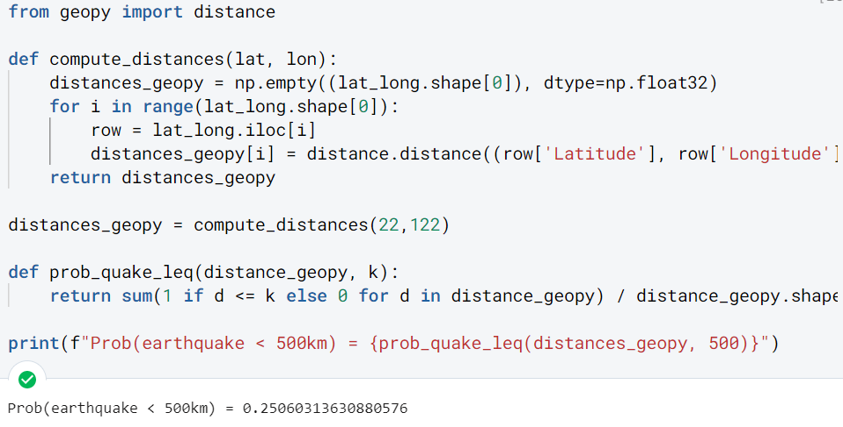
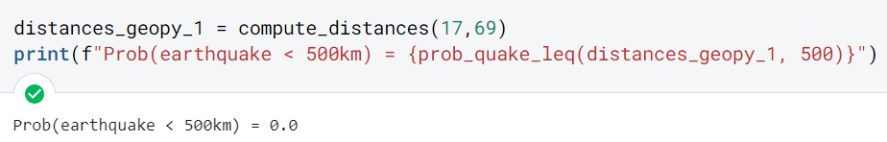
Proposed Method
Propose using a method which calculates the probability by finding the number of earthquakes in a radius around the location, divided by the total number of earthquakes
More accurate as it takes into account the frequency of earthquakes in a radius around the chosen location.
Chose radius of 500 km because most powerful earthquake could be felt 1000 km away and a magnitude 5.5 earthquake usually can be felt as far as 500km away.
Near the centroid of a cluster Coordinates: (122,22)
Location very far from centroid of nearest cluster Coordinates: (69,17)
Probability is zero, which is reasonable given that there is only one earthquake within 500 km radius, and hence the probability would be too close to zero.
Notes:
Hence, we propose using a method where we calculate the probability of an earthquake at a location by finding the number of earthquakes in a radius around the location, divided by the total number of earthquakes, which would be more accurate, as it takes into account the frequency of earthquakes in a radius around the chosen location.
In our case, we have decided to choose the radius to be 500km because when doing our research, we found out that the most powerful earthquake in history could be felt 1000km away. In addition, a magnitude 5.5 earthquake usually can be felt as far as 500km away. As such, we decided that 500km would be a good guideline for our radius.
Using our proposed method to calculate the probability of an earthquake happening at the same 2 points chosen for the K-Means model earlier, we can see that for the first point, the probability is about 0.23 while for the second point, the probability is zero, which is reasonable given that there is only one earthquake within 500km radius, and hence the probability would be too close to zero.

Slide 30
Thank You

